Slide 1
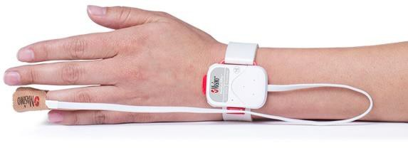
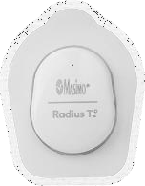
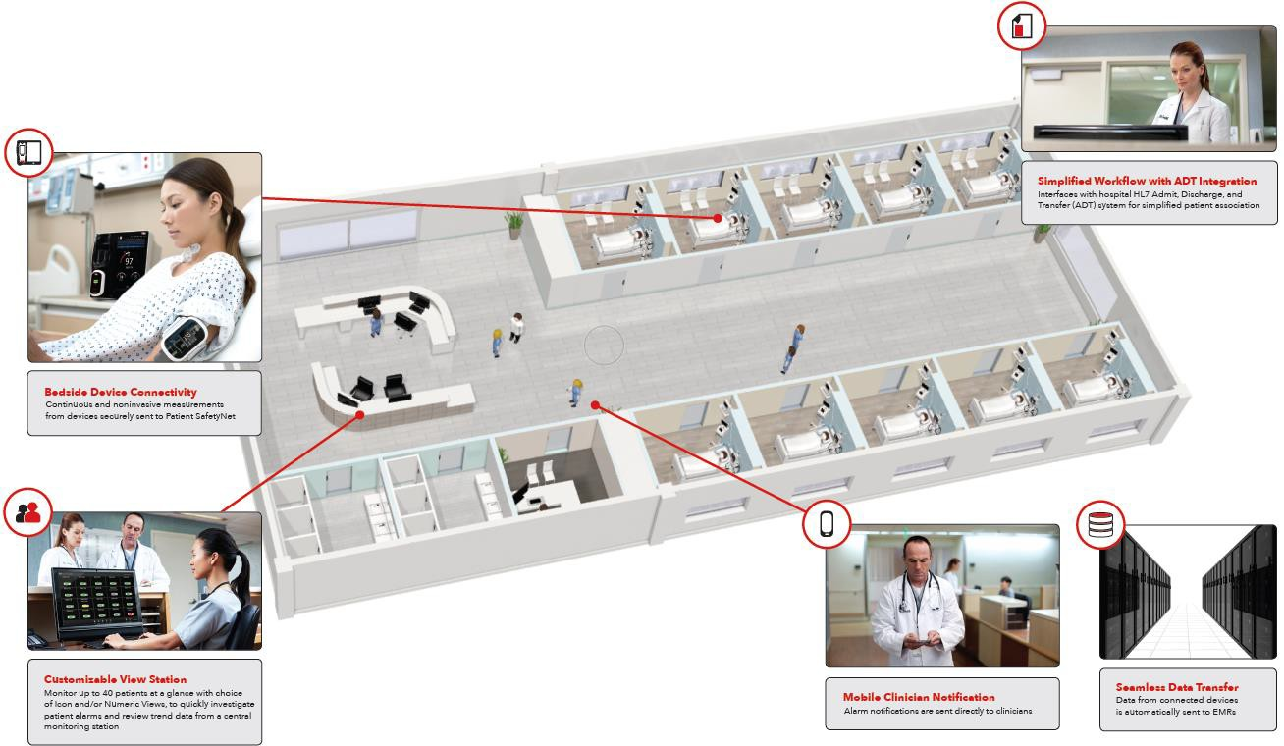
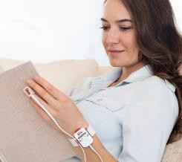
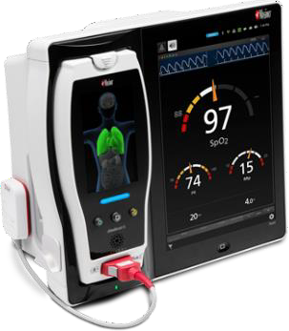
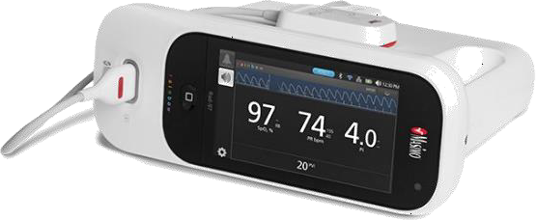
Tetherless Pulse Oximetry
Patient SafteyNet
Remote monitoring and Clinician Notification system which displays near real-time information from any connected Masimo device at a central station and allows for alarms and alerts from bedside devices to be sent directly to clinicians.
Radius PPG Neo Sensor
Radius Tº* (Temp)
Radius PPG™ - Hospital based tetherless pulse oximetry
Continuous wireless surveillance of patients in hospital. Pairs with Rad-97 or Radical-7.
Code: 4776 – Radius Tº*
Code: 9954 (Neo) 9954 (Adt) – Radius PPG Kit (pairs to Rad-97 or Radical-7)
Masimo Rainbow & SET technology
Parameters: SpO2, PR, Pi, PVi, RRp, Temp (optional)
Single Patient Use sensor uses Bluetooth to connect to a host device. Brand: Masimo
Root with Radical-7 & Radius PPG receiver
Rad-97 with Radius PPG receiver
Dec 2021

Slide 2
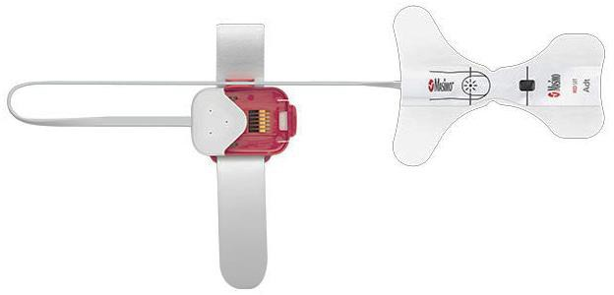
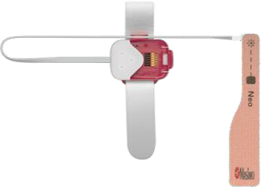
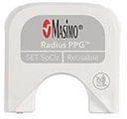
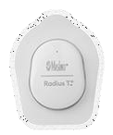
Tetherless pulse oximetry
Hospital based tetherless pulse oximetry
Radius PPG: Continuous wireless surveillance of patients in hospital.
Pairs with Rad-97 or Radical-7.
Radius PPG
Single patient use Radius PPG Adt For Adults, >30kg | Single patient use Radius PPG Neo For Adult/Neonatal, Weight <3kg or >40kg
4582: Radius PPG Adt, Adult SpO2 Adhesive Sensor | 4585: Radius PPG Neo, Adult/Neonatal SpO2 Adhesive Sensor
Radius PPG Reusable Chip Reusable Wireless Transmitter Includes Chip and Chip Holder | 4674: Neo Replacement Tapes, Large, For use with Radius PPG Neo. Also available for use with RD & LNCS SET Neo
4586: Radius PPG Reusable Chip, reusable wireless transmitter 1/box includes chip and chip holder.
Radius T° for Masimo SafetyNet 8-day supply Includes: 1 Radius Tº sensor Can also be connected to Masimo SafetyNet
4776: Radius T ADLT/PED Cntns Body Temp Sns

Slide 3
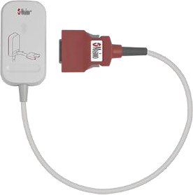
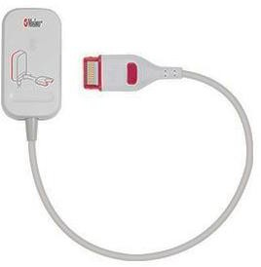
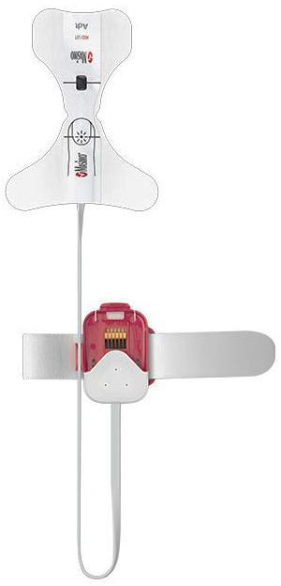
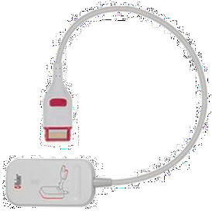
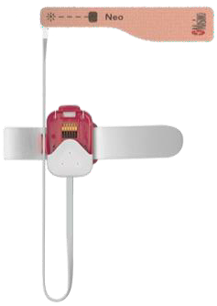
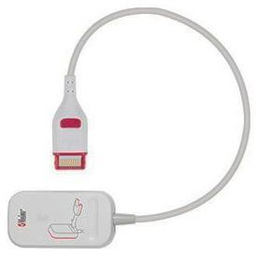
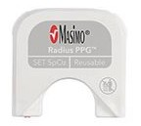
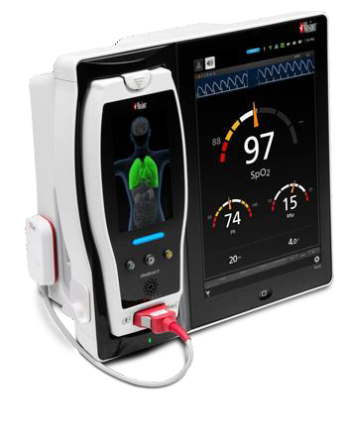
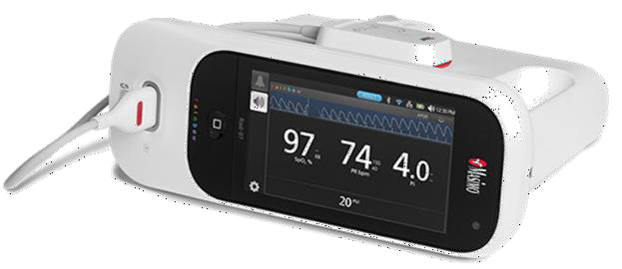
Tetherless pulse oximetry
Hospital based tetherless pulse oximetry
Radius PPG: Continuous wireless surveillance of patients in hospital.
Pairs with Rad-97 or Radical-7.
Radius PPG Neo Sensor
Radius PPG
Radius PPG Wireless Receiver MD20 Wireless Receiver with MD20 Connector For use with Radius PPG Sensor, Radius PPG Chip & Radical 7 with updated MX board (SW version MX 7.14.8.x or higher) | Radius PPG Wireless Receiver M20 Wireless Receiver with MD20 Connector For Rad-97 with M20 Connector
4588: Radius PPG Wireless receiver for Radical 7 MD20 connector | 4587: Radius PPG Receiver M20, Wireless Receiver for RAD97 with M20 Connector
Radius PPG Kit, Neo Adt Adult | Radius PPG Kit, Neo Adult/ Neonatal
9954: Radius PPG Kit, Adt comes with: 4582 x20 Radius PPG Adult Adhesive sensors 4586 x1 PPG Reusable chip 4588 (MD20) or 4587 (M20) x1 PPG wireless receiver x1 MD20 or M20 cable. | 9955: Radius PPG Kit, Adult/Neo comes with: 4585 x20 Radius PPG Adult Adhesive sensors 4586 x1 PPG Reusable chip 4588 (MD20) or 4587 (M20) x1 PPG wireless receiver x1 MD20 or M20 cable.
Root with Radical-7 & Radius PPG receiver
Rad-97 with Radius PPG receiver

